Slide 1

Hacking Wireless Networks
Rumman Ahmed
Wasfi Momen
Cryptography

Slide 2
Introduction
The data communicated can be seen by everyone in the network, so it is important to keep the communication secure
Why hack Wi-Fi?
Go on the internet anonymously
Use someone else’s bandwidth to download your own large files or torrents
Spy on user traffic and intercept sensitive info

Slide 3
Security Protocols
There are established security protocols when dealing with the connection to wireless networks
The reason these protocols are in place:
To prevent random users from connecting to your network
To encrypt the communication over the network
They have changed throughout the years, mainly because major security flaws were discovered in the former

Slide 4
WEP (Wired Equivalent Privacy)
Original standard developed for wireless networks
Flawed because it allows keys to be reused in the encryption and only had a 24-bit initialization vector (IV), which is very small
IVs are used along with a secret key to encrypt data
For a busy network, the same IV may be used for two clients, which allows attackers to decipher the key

Slide 5
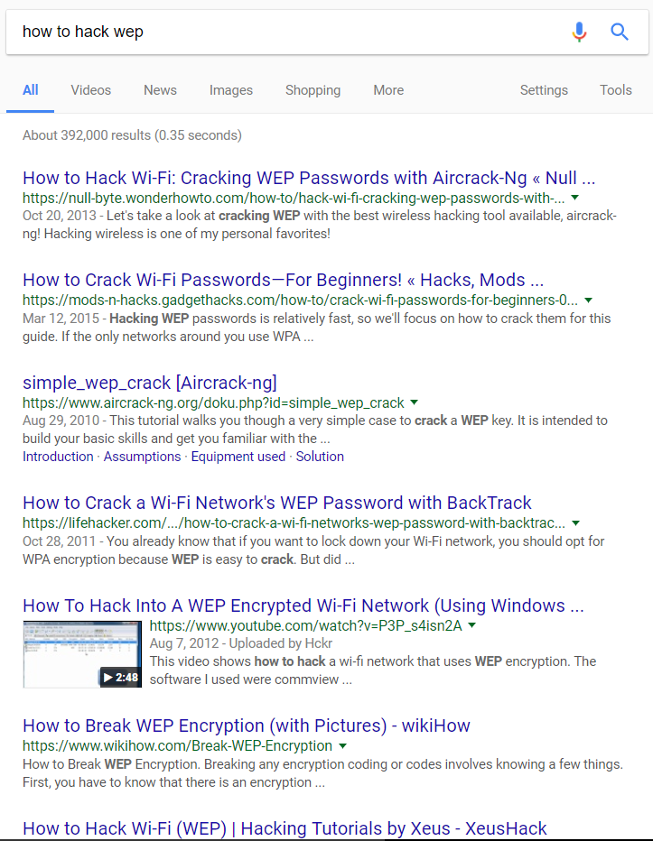
How to Hack WEP…Just Use Google

Slide 6
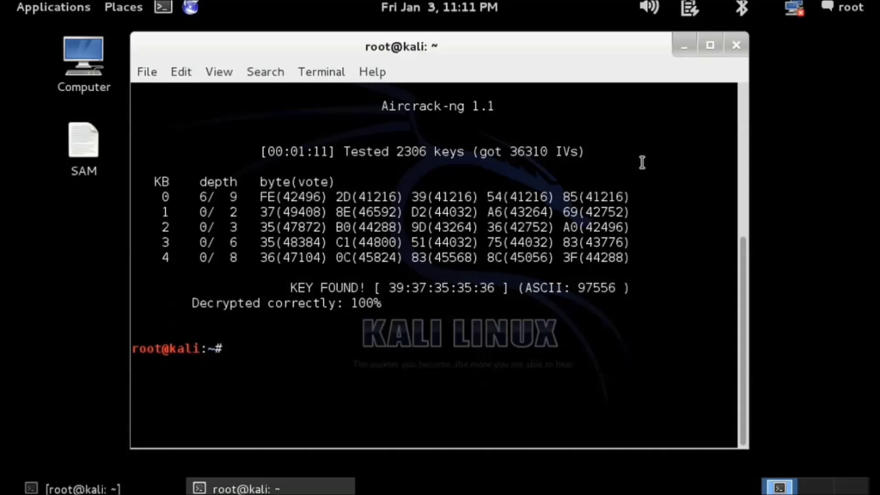

Slide 7
WPA (Wi-Fi Protected Access)
This was a partial new standard implemented when the flaws of WEP were discovered
Increased the initialization vector (48 bits) and the master key (128 bits)
Introduces Temporal Key Integrity Protocol (TKIP), which is a set of algorithms to help with encryption (now deprecated)

Slide 8
WPA2
This is the full implementation of the WPA standard, finalized in 2004
Most important addition is the use of CCMP and AES for key encryption
This standard was mathematically proven to be secure

Slide 9
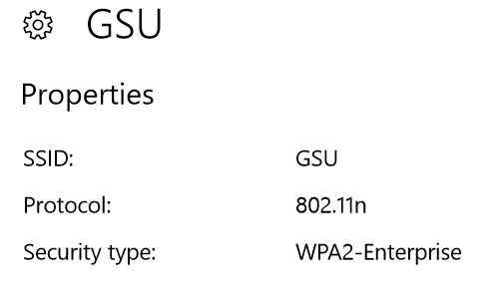
How to Hack WPA/WPA2
ARP Spoofing: used to make the access point think the attacker is the real user (man in the middle attack)
WPA2-PSK vs WPA2-Enterprise
WPA2-PSK is used by home networks and places like coffee shops. Anyone who connects can observe and decrypt other’s traffic because of a shared key
WPA2-Enterprise fixes this as every client has a unique key

Slide 10
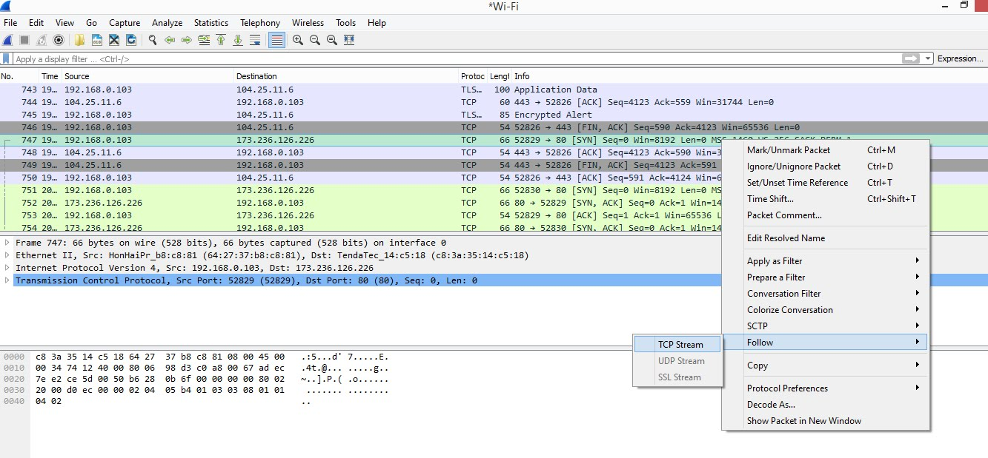

Slide 11
How to Hack WPA/WPA2
The former techniques require you to actually connect to the network
You are protected if your traffic is encrypted (HTTPS)
Up until earlier this year, these techniques were assumed the only ways to compromise wireless networks
Now there’s a way to hack a protected WPA2 network even without the password

Slide 12
Key Reinstallation Attack (KRACK)
This exploit was discovered by Mathy Vanhoef and presented at the ACM security conference in the beginning of November 2017
The hack compromises all modern WPA2 networks, with Linux and Android devices being the most vulnerable
Attackers, who are within range of the device or access point, can intercept data, including passwords, emails, and all other encrypted data

Slide 13
4-Way Handshake
KRACK targets the 4-way handshake that occurs when a client connects to a WPA2 network
During the handshake:
Verifies the client has the correct credentials
Generates an encryption key for the communication

Slide 14
4-Way Handshake (continued)
After message 3, the key is sent from the access point to the client and installed
However, if messages are lost (if message 3 was never received), the access point will resend and install the same key
This prompts the IV to be reset to the same value each time
Attackers can now use the IV to launch a replay attack to figure out what they key is

Slide 15
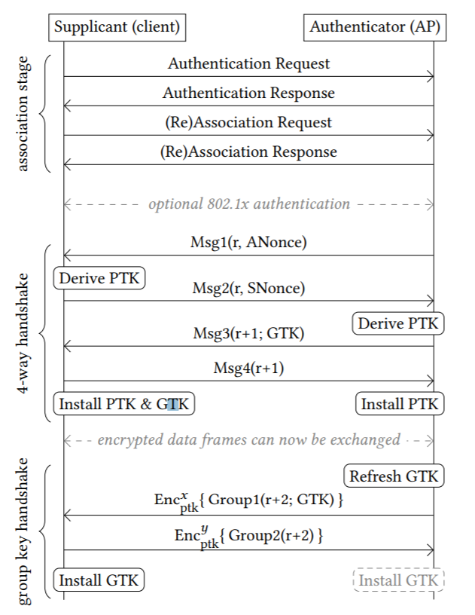

Slide 16
Effects
This exploit affects all modern WPA2 networks
Android and Linux devices are much more vulnerable, as the IV gets reset to 0 instead of what it was initially, so attackers don’t even have to figure out the IV
Windows and iOS devices don’t allow the retransmission of message 3, so they are considered more safe

Slide 17
Effects
Both the clients (our phones, laptops, and other Wi-Fi capable devices) and the access points will need to be updated
Security patches have been rolling out since the discovery (privately told to some vendors in July)
It is important to be kept up to date with wireless security, considering how much sensitive data we send and receive

Slide 18
Implementation of key exchange in WPA2 handshake
Try to model how tools and routers compute these keys in the exchange
Coffee shop wifi setup, we know the password
Use Wireshark to capture the handshake
Use Python to derive keys
Algorithms: HMAC-SHA1, PBKDF2

Slide 19
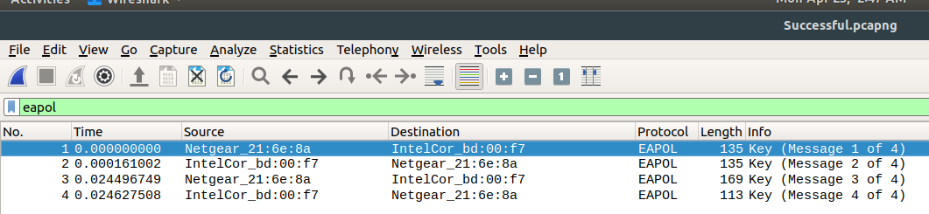
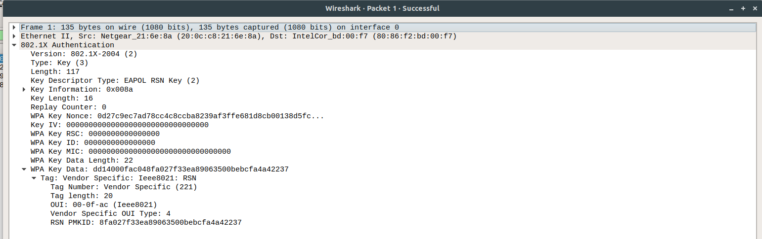
Capture Handshake

Slide 20

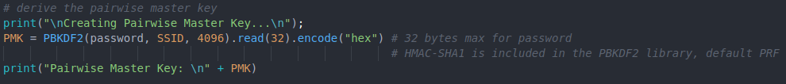
Derive the PMK

Slide 21
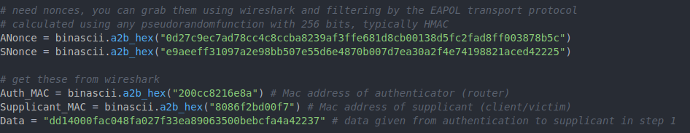
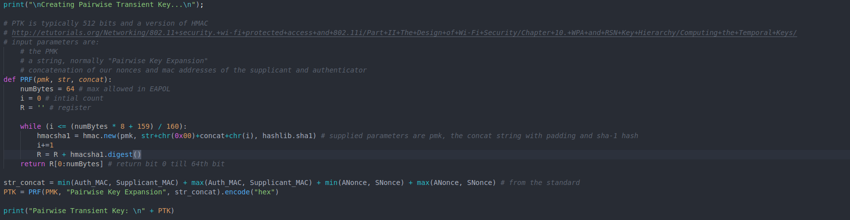
Derive the PTK

Slide 22
Conclusion
By researching past vulnerabilities of cryptography algorithms and simulating the handshake process, we were able to understand how different attacks can compromise data transmitted between two parties via a wireless network.
Passphrase really does matter.
WPA3 is scheduled to be announced as a new amendment to the 802.11 standard very soon.
There are still some issues not addressed, like deauthentication attack and coffee shop wifi sniffing

Slide 23
References
https://papers.mathyvanhoef.com/ccs2017.pdf
https://www.krackattacks.com/
http://searchsecurity.techtarget.com
https://www.veracode.com/security/arp-spoofing
https://www.howtogeek.com/204335/warning-encrypted-wpa2-wi-fi-networks-are-still-vulnerable-to-snooping/

Slide 24
Thank you

